Slide 1
Rental Fleet Management System
Jacob Miller, Patrick Riley, Nathan Warden, Brian Wieder, Donghyeon Shin, Mehak Kamal (Group 8)

Slide 2
Background

Slide 3
Project Background
Our design project is a rental car fleet management system
Our goal is to design a user friendly web and mobile application that the management system will run on and allow customers to make quick transactions
The system will differentiate users by account roles and each different role will have different limitations
Managers, employees, and customers
The system inventory will update frequently and process transactions immediately so customers can always see what is available
The user interface for the web and mobile applications will be disability friendly

Slide 4
Motivation

Slide 5
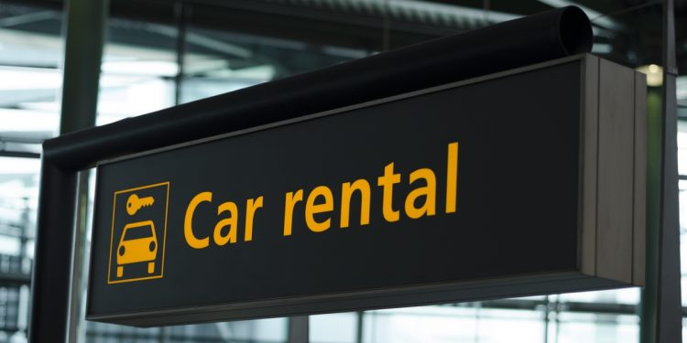
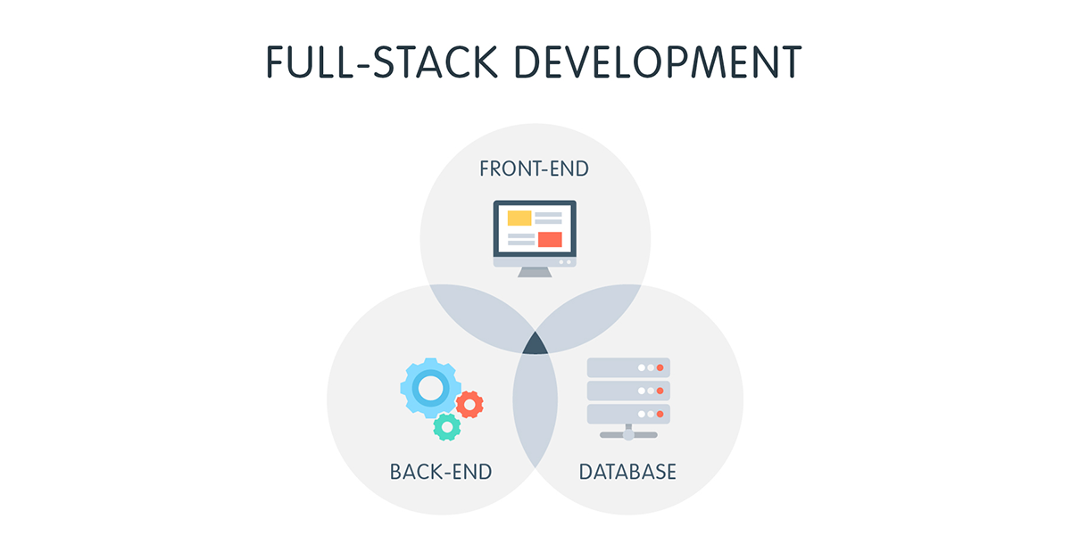
Motivation
This project utilizes front-end web development, front-end mobile development, and back-end development.
This allows us to get a sense of designing for multiple types of development, and figure out what areas that we might want to pursue after graduation.
This is a real problem that a company could ask us to develop.
Get hands on experience going through the design process just like we would at a job/internship.

Slide 6
Requirements

Slide 7
Customer Transactions
System will charge the remaining cost of the transaction plus the cost of any additional fees due to damage or other things.
Customers can cancel pending rentals at any time. Cancellations occurring within a set time period will charge a late cancellation fee.
Customers can provide coupon codes to receive special and promotional discounts and reduced rates
Notes:
After dropping off the vehicle and an employee has verified the drop off, the customers card will be charged for the total amount of the transaction plus any fees accrued by the customer.
Customers can cancel pending rentals at any time. If a rental is cancelled before the scheduled pickup time, but within a set window (24hours for example), the system will automatically charge the customer a late cancellation fee.
When checking out, the system will provide an area to provide coupon codes and keep track of available coupon codes to allow promotional deals.

Slide 8
Customer Transactions
Customers can perform a monetary transaction for one or multiple vehicles available in the rental fleet. Pre-pickup there will be a small pending charge ($1) to filter the cases where the card is declined. Refunded after drop off.
Customers receive receipts via email and can view past transaction information. Likely from within their account information page.
Customers can apply points they have earned from previous transactions without the need to sign up for a separate rewards program.
Notes:
Customers can perform a transaction with the system via checking out one or more vehicles available in the rental fleet. This will be done by entering in credit/debit card information via a form. Upon submission of the card information, the customer will be hit with a small $1 pending charge to act as an extra step of card validation. This is similar to how you give your card information to gas pump machine before you pump the gas in your car. After returning the rental vehicle, this pending charge will be removed.
Customers will receive a confirmation email with some order details, customers will also be able to view their past transactions
Customers can apply their points that they gain from previous transactions, this system is much better for the customer than a traditional rewards system as normal rewards systems require customers to explicitly sign up for the program.

Slide 9
Customer Interaction
Customers can filter available vehicle by how many seats they need or the type of vehicle they want.
Customers can upload pictures of the rental vehicle during pickup and after drop-off. This would allow customers to document any damages to the car that happened before they were in possession of the vehicle.
Customers can login with Google or Apple.
Customers can update their account information.

Slide 10
Customer Interaction
Customers should be able to compare the features of two different vehicles.
Customers should be able to login with an email address and password.
Customers should have the ability to see which cars are available at a rental location.
Users should be able to save vehicles that they are interested in renting. This would allow customers to browse for potential vehicles before they decide which one they would like to rent.

Slide 11
Transactional Manager Requirements
Managers can authorize refunds and discounts to customers. This would allow for managers to provide a refund or discount if something occurred during the rental process in order to remedy a bad customer experience.
Managers can create custom offers for enterprise customers who negotiated a custom rate. This would allow managers to form partnerships with companies who need to rent lots of vehicles over a period of time.

Slide 12
Functional Manager Requirements
Managers can override decisions made by the System. An example of this would be allowing the rental of a vehicle nearing its preventative maintenance deadline, but the customer has voiced they will not be able to exceed the deadline.
Managers can track the location of vehicles. Allows cooperation with authority and prevents any employee from maliciously tracking customers.

Slide 13
Employee Actions
Employee should be able to add new cars to the fleet.
Employee should be able to remove a car from the fleet.
The System and Employees should be able to reserve a car in the fleet
Employees should be able to approve or deny customer rental requests.
The system should flag vehicles and alert employees when a vehicle is approaching a deadline for preventative maintenance.

Slide 14
Non-Functional
Most popular languages supported
Customers can interact with the system through a web application
Customers can interact with the system via mobile application
UI color theme strays away from colors that are known to be less visible to those with disabilities such as color blindness
System capable of processing 1,000 transactions per hour
Inventory updated every few seconds

Slide 15
Foreseen Challenges

Slide 16
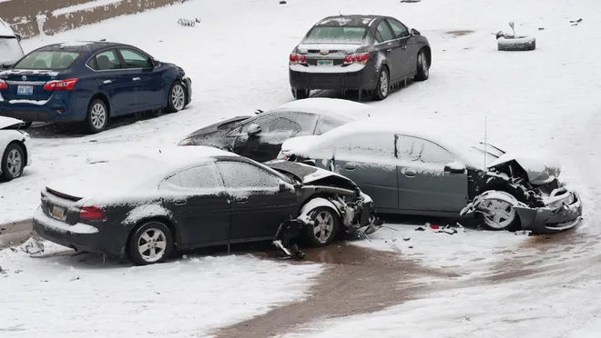
Development Challenges
Accommodating different car types
Preventing rental/insurance fraud
Ensuring accessibility across different devices
Handling cancellations and accidents
Storing large amounts of location and condition data

Slide 17
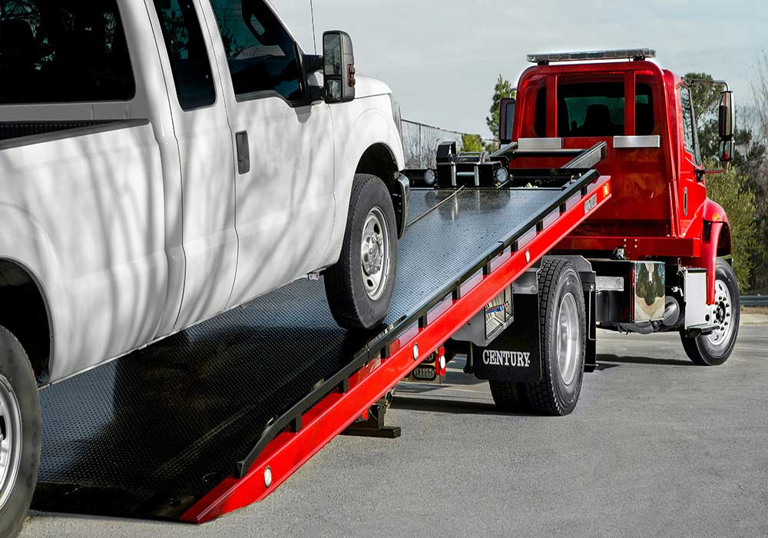
Possible Solutions
Brand-agnostic classification
AI/ML fraud detection systems
Real Time inventory updates and automatic reporting
Distributed data storage (Blue-Green Deployments)

Slide 18
Questions?

